Slide 1
Wine Quality Testing
Venkata Kanishk Chaganti
Sagar Vora
Notes:
ID=d924773e-9a16-4d6d-9803-8cb819e99682 Recipe=text_billboard Type=TextOnly Variant=0 FamilyID=AccentBoxWalbaum_Zero

Slide 2
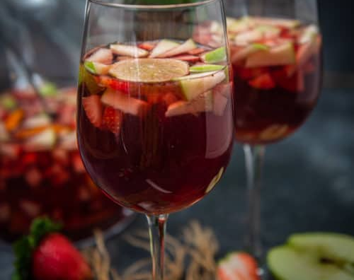
Agenda
Dataset
Assumptions
Transformations
multicollinearity
variable selection
F-test
Regression models

Slide 3
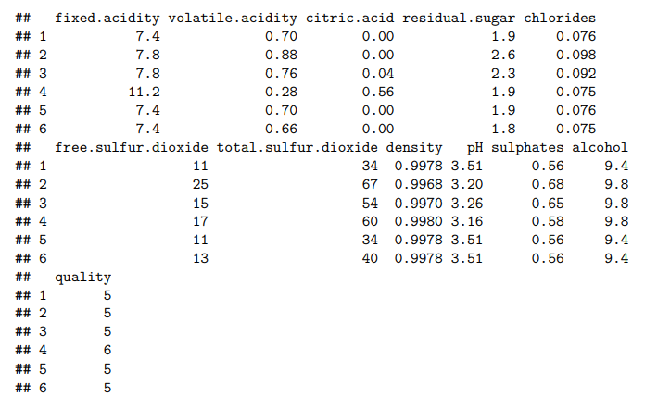
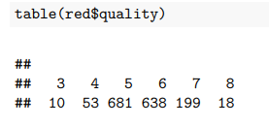
Dataset
Table
A Red Wine Testing:
Response Variable – quality ,
Predictor Variable : Rest of the variables.

Slide 4
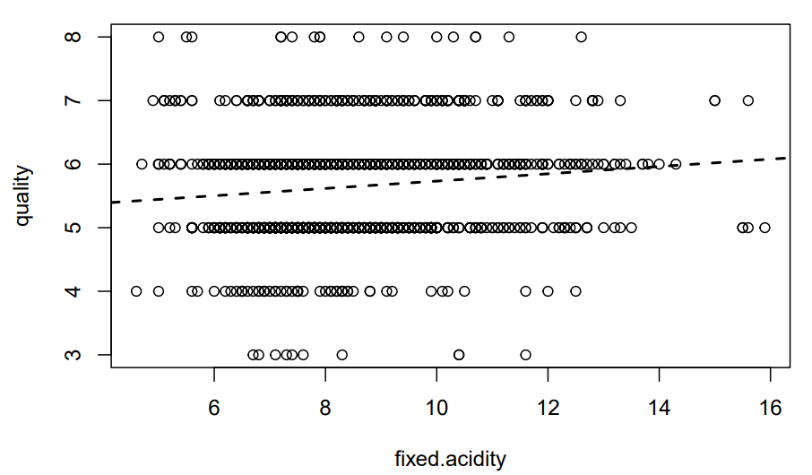
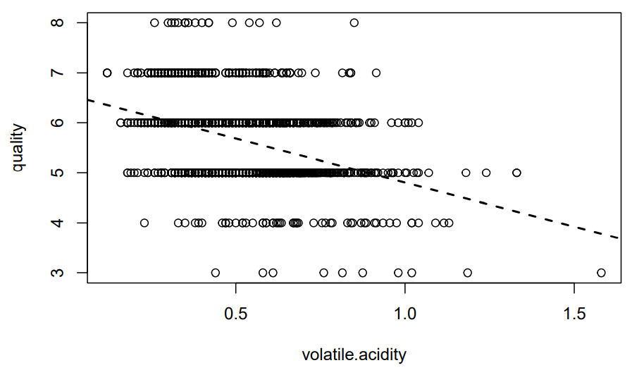
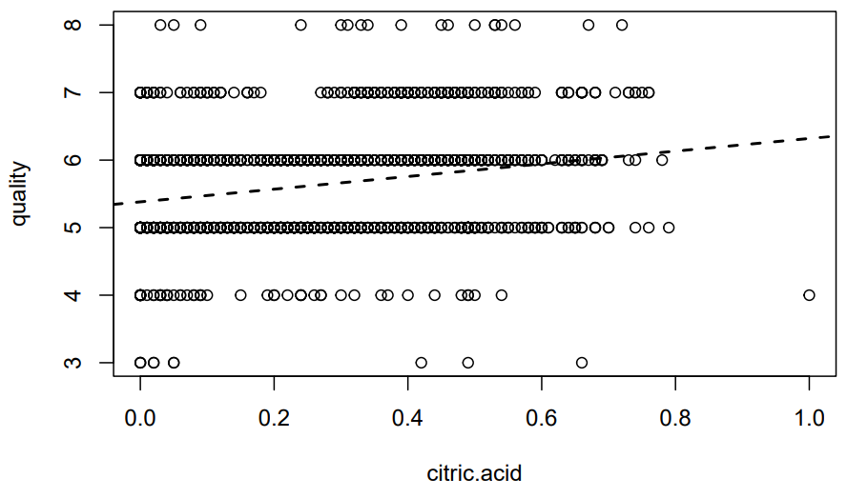
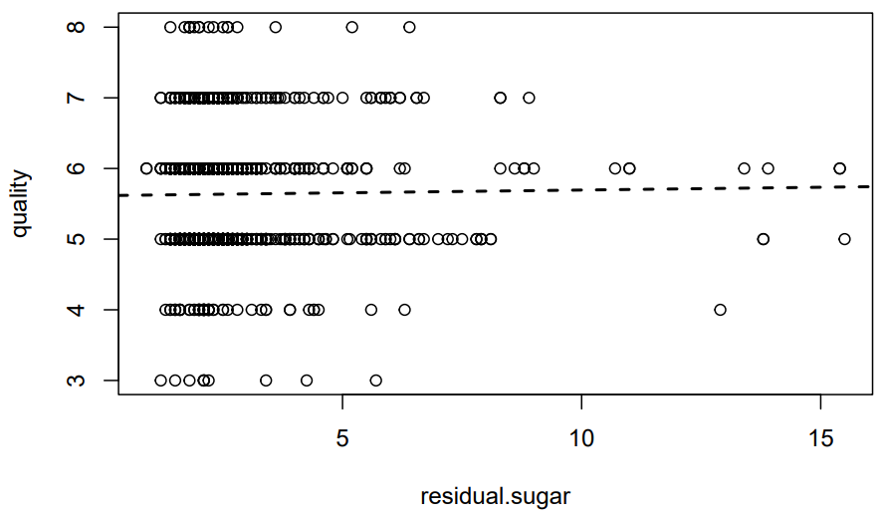
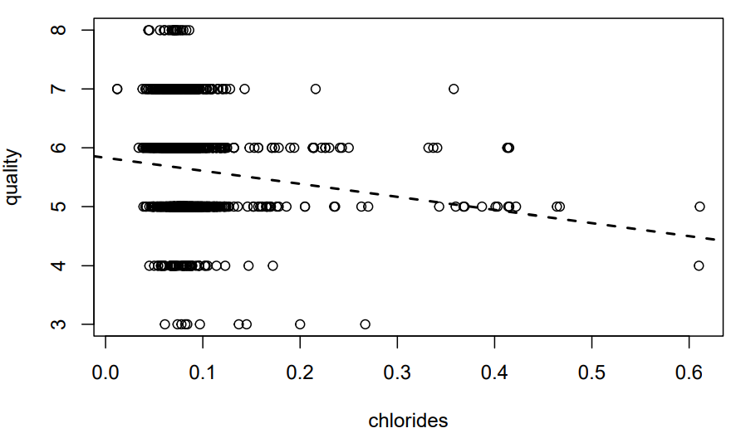
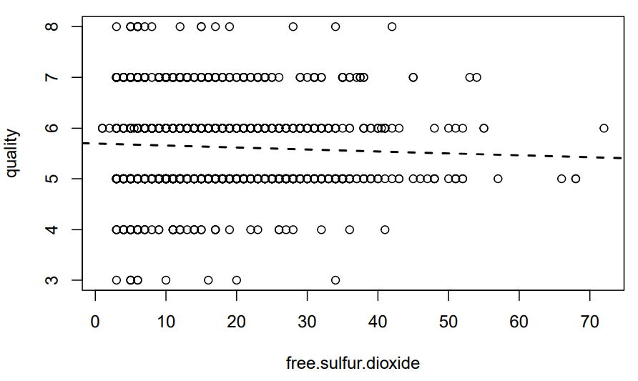
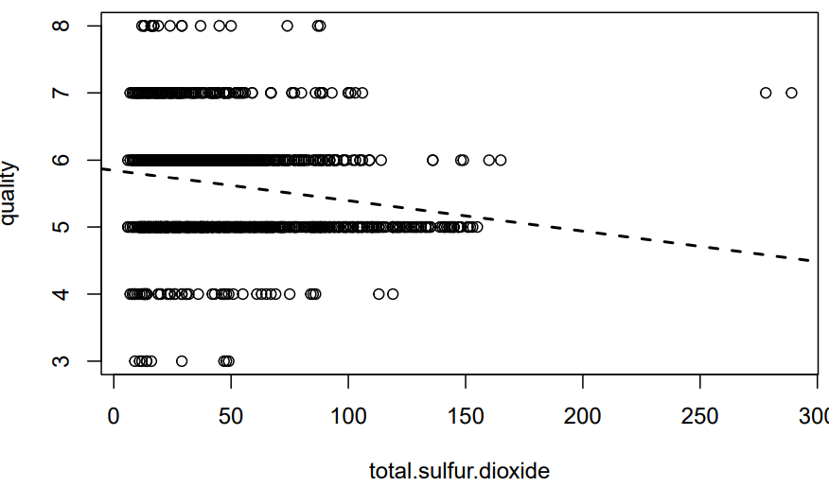
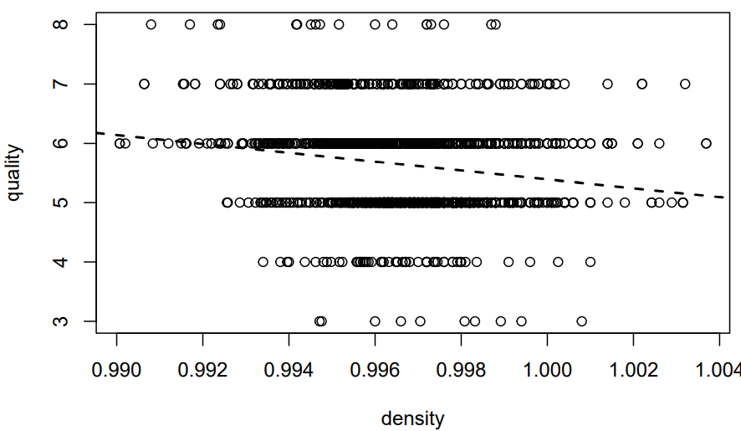
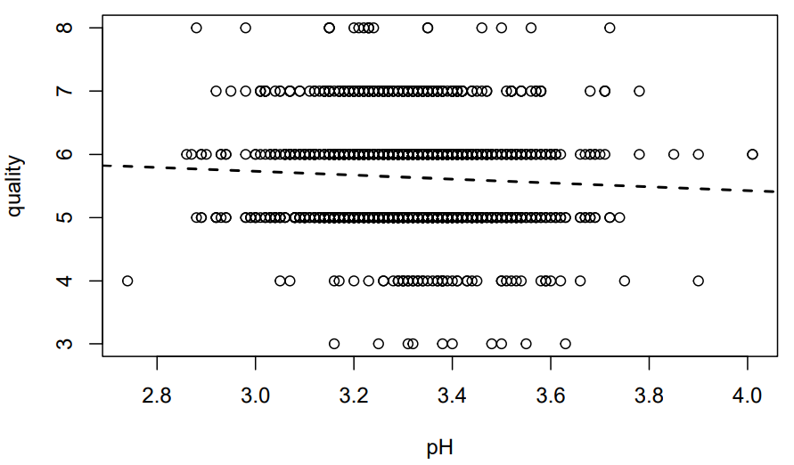
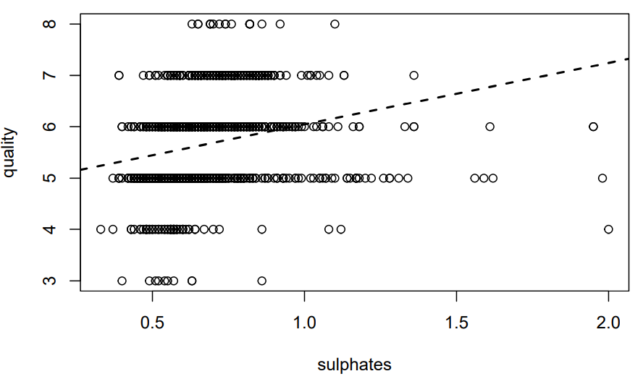
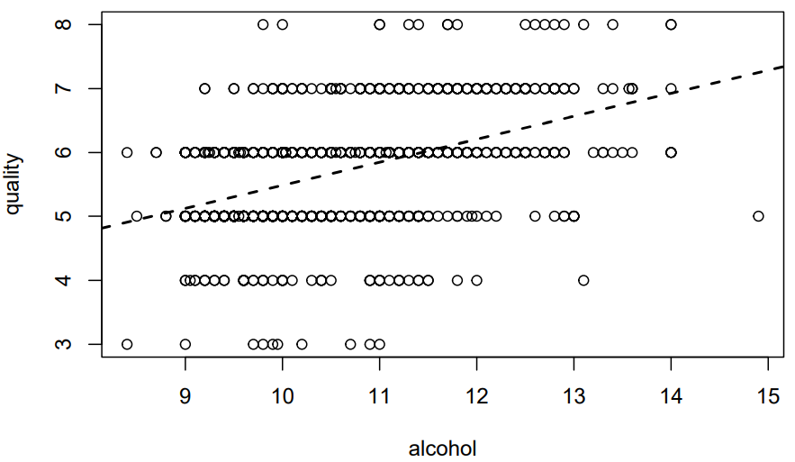
Assumptions

Slide 5
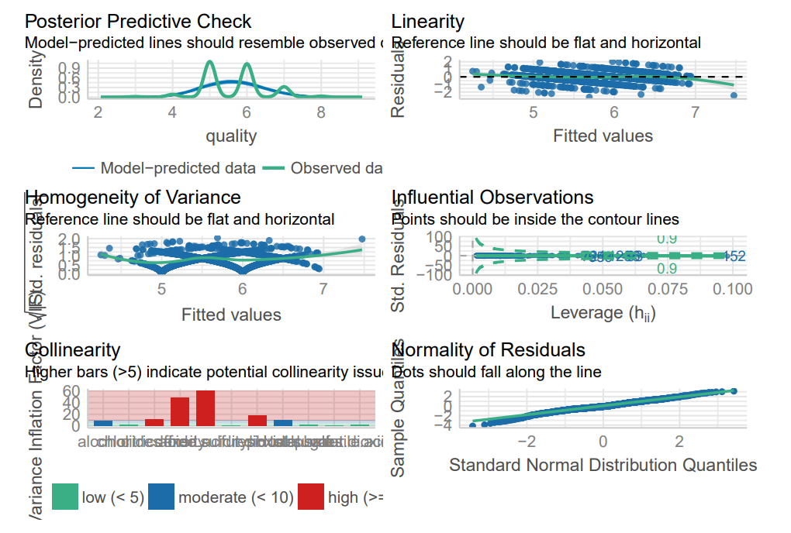
Assumptions
Linearity looks good.
Non patterns are observed in residuals and fitted values plot, so we can say that the data follows constant variance.
As we can see that there are 4 variables which have a higher bar, so Collinearity gets violated.
In normality plot points seems to be disturbed at the start and end but looks reasonable.
There are minimal residuals found.

Slide 6
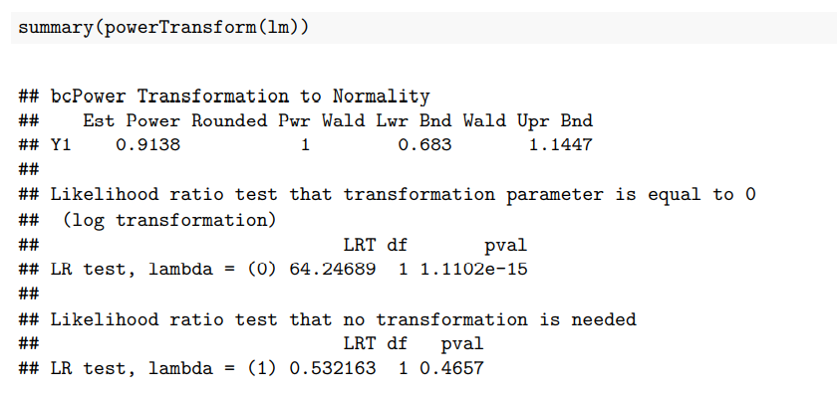
Transformations
λ =1
No transformation is needed

Slide 7
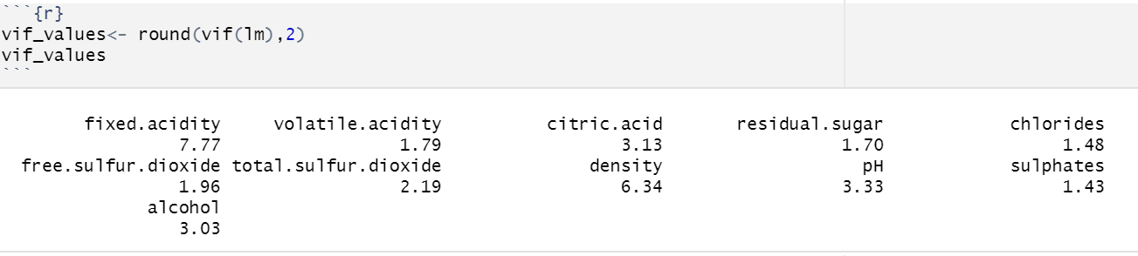
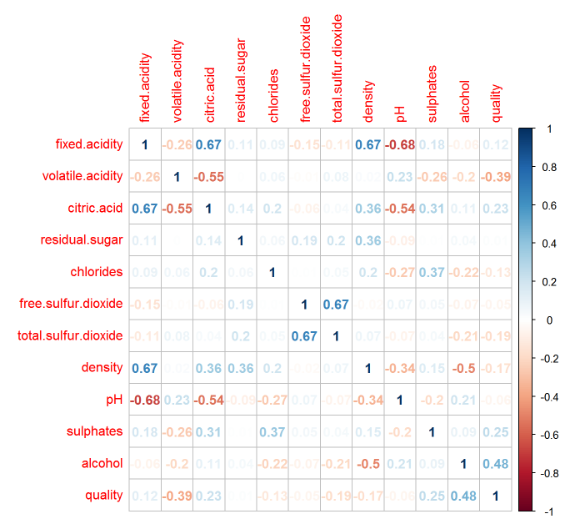
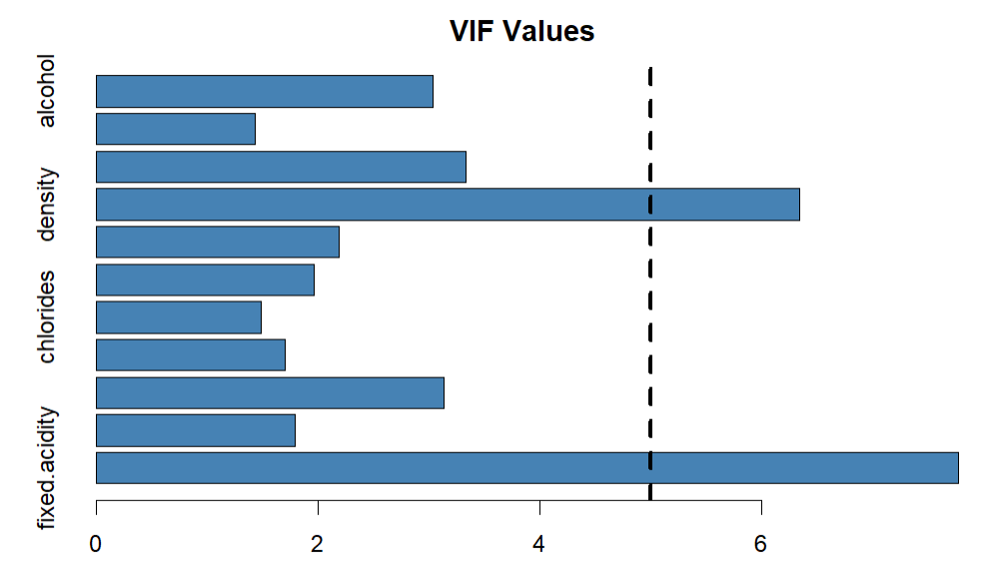
Multicollinearity
Variance Inflation Factor
Correlation Matrix

Slide 8
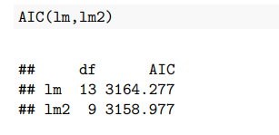
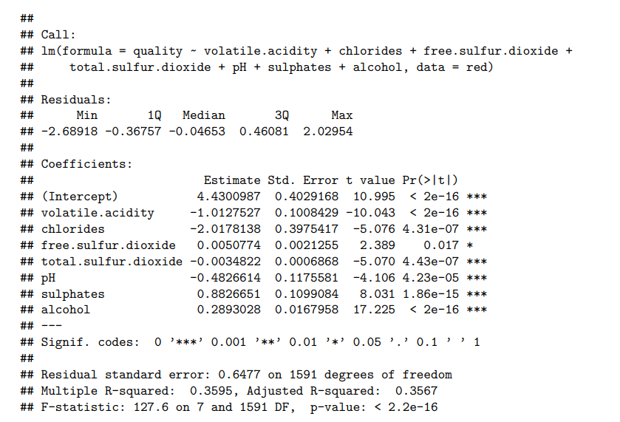
Variable Selection
fixed.acidity, citric.acid, residual.sugar, density are not significant for determining quality of red wine.

Slide 9
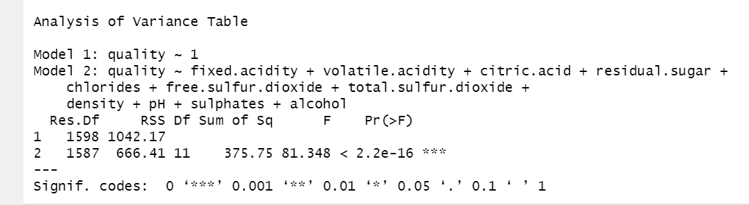
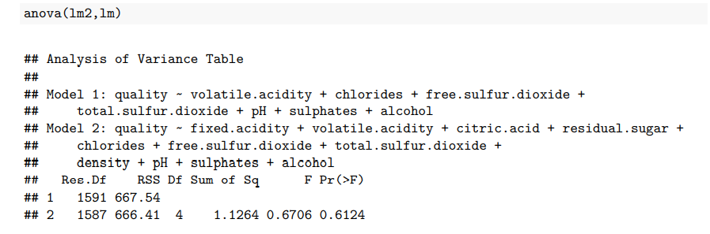
F-Test
H0: β1 = β2 = ...β11 = 0
Ha: at least one β j ≠ 0
H0 : β1 = β3 = β4 = β8 = 0
Ha :β1 ≠ 0 or β3 ≠ 0 or β4 ≠ 0 or β8 ≠ 0

Slide 10

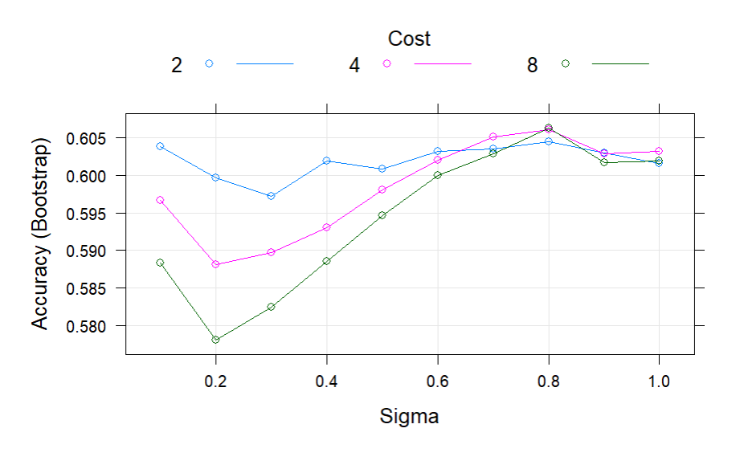
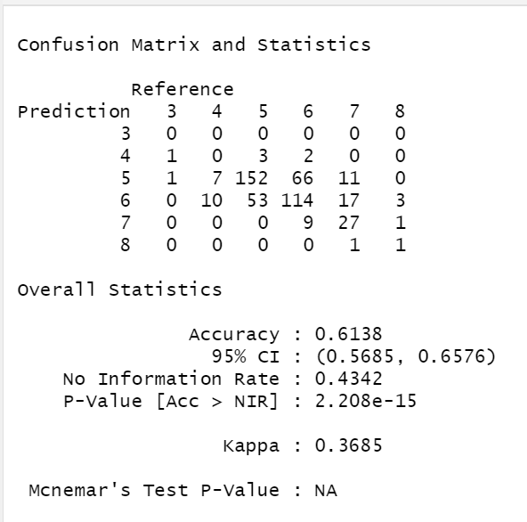
Support Vector Machine

Slide 11
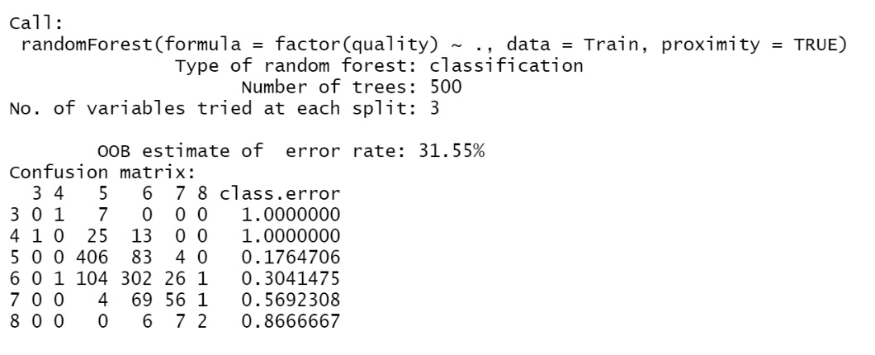
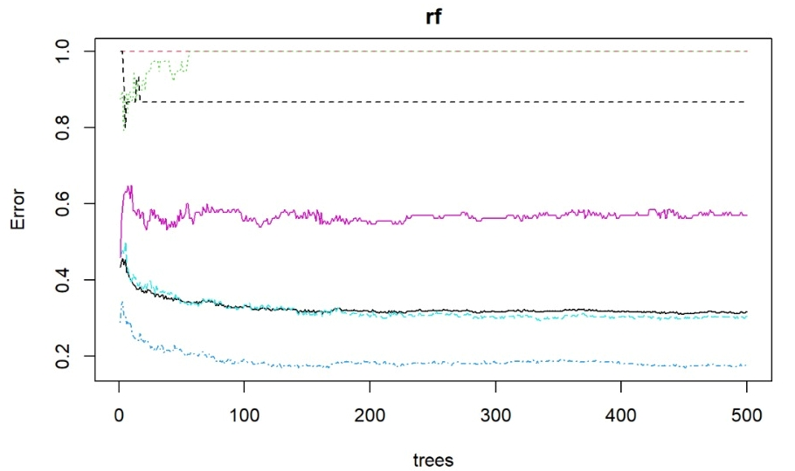
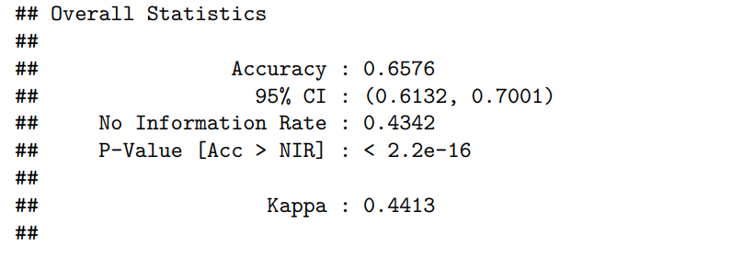
Random Forest

Slide 12
Conclusion
As the accuracy of random forest is much greater then any of the other regression model, we can conclude that it works best for predicting the quality of red wine.
Thank you.

